Slide 1

Predicate Logic
Rosen 6th ed., § 1.3-1.4

Slide 2
Predicate Logic
Predicate logic is an extension of propositional logic that permits concise reasoning about whole classes of entities.
E.g., “x>1”, “x+y=10”
Such statements are neither true or false when the values of the variables are not specified.

Slide 3
Applications of Predicate Logic
It is the formal notation for writing perfectly clear, concise, and unambiguous mathematical definitions, axioms, and theorems for any branch of mathematics.
Supported by some of the more sophisticated database query engines.
Basis for automatic theorem provers and many other Artificial Intelligence systems.

Slide 4
Subjects and Predicates
The proposition
“The dog is sleeping”
has two parts:
  “the dog” denotes the subject - the object or entity that the sentence is about.
  “is sleeping” denotes the predicate- a property that the subject can have.

Slide 5
Propositional Functions
A predicate is modeled as a function P(·) from objects to propositions.
  P(x) = “x is sleeping” (where x is any object).
The result of applying a predicate P to an object x=a is the proposition P(a).
  e.g. if P(x) = “x > 1”,
  then P(3) is the proposition “3 is greater than 1.”
Note: The predicate P itself (e.g. P=“is sleeping”) is not a proposition (not a complete sentence).

Slide 6
Propositional Functions
Predicate logic includes propositional functions of any number of arguments.
e.g. let P(x,y,z) = “x gave y the grade z”,
x=“Mike”, y=“Mary”, z=“A”,
P(x,y,z) = “Mike gave Mary the grade A.”

Slide 7
Universe of Discourse
The collection of values that a variable x can take is called x’s universe of discourse.
e.g., let P(x)=“x+1>x”.
we could define the course of universe as the set of integers.

Slide 8
Quantifier Expressions
Quantifiers allow us to quantify (count) how many objects in the universe of discourse satisfy a given predicate:
- “∀” is the FOR∀LL or universal quantifier.
∀x P(x) means for all x in the u.d., P holds.
- “∃” is the ∃XISTS or existential quantifier.
∃x P(x) means there exists an x in the u.d. (that is, one or more) such that P(x) is true.

Slide 9
Universal Quantifier ∀: Example
Let P(x) be the predicate “x is full.”
Let the u.d. of x be parking spaces at GSU.
The universal quantification of P(x),
∀x P(x), is the proposition:
  “All parking spaces at GSU are full.” or
  “Every parking space at GSU is full.” or
  “For each parking space at GSU, that space is full.”

Slide 10
The Universal Quantifier ∀
To prove that a statement of the form
∀x P(x) is false, it suffices to find a counterexample (i.e., one value of x in the universe of discourse such that P(x) is false)
  e.g., P(x) is the predicate “x>0”

Slide 11
Existential Quantifier ∃ Example
Let P(x) be the predicate “x is full.”
Let the u.d. of x be parking spaces at GSU.
The existential quantification of P(x),
∃x P(x), is the proposition:
  “Some parking spaces at GSU are full.” or
  “There is a parking space at GSU that is full.” or
  “At least one parking space at GSU is full.”

Slide 12
Quantifier Equivalence Laws
Definitions of quantifiers: If u.d.=a,b,c,…
∀x P(x) ⇔ P(a) ∧ P(b) ∧ P(c) ∧ …
∃x P(x) ⇔ P(a) ∨ P(b) ∨ P(c) ∨ …
We can prove the following laws:
∀x P(x) ⇔ ¬∃x ¬P(x)
∃x P(x) ⇔ ¬∀x ¬P(x)
Which propositional equivalence laws can be used to prove this?
DeMorgan's

Slide 13
More Equivalence Laws
¬∃x P(x) ⇔ ∀x ¬ P(x)
¬∀x P(x) ⇔ ∃x ¬ P(x)
∀x ∀y P(x,y) ⇔ ∀y ∀x P(x,y)
∃x ∃y P(x,y) ⇔ ∃y ∃x P(x,y)
∀x (P(x) ∧ Q(x)) ⇔ (∀x P(x)) ∧ (∀x Q(x))
∃x (P(x) ∨ Q(x)) ⇔ (∃x P(x)) ∨ (∃x Q(x))

Slide 14
Scope of Quantifiers
The part of a logical expression to which a quantifier is applied is called the scope of this quantifier.
e.g., (∀x P(x)) ∧ (∃y Q(y))
e.g., (∀x P(x)) ∧ (∃x Q(x))

Slide 15
Free and Bound Variables
An expression like P(x) is said to have a free variable x (meaning x is undefined).
A quantifier (either ∀ or ∃) operates on an expression having one or more free variables, and binds one or more of those variables, to produce an expression having one or more bound variables.

Slide 16
Examples of Binding
P(x,y) has 2 free variables, x and y.
∀x P(x,y) has 1 free variable, and one bound variable. [which is which?]
“P(x), where x=3” is another way to bind x.
An expression with zero free variables is an actual proposition.
An expression with one or more free variables is still only a predicate: ∀x P(x,y)
y
x

Slide 17
More to Know About Binding
∀x ∃x P(x) - x is not a free variable in
∃x P(x), therefore the ∀x binding isn’t used.
(∀x P(x)) ∧ Q(x) - The variable x is outside of the scope of the ∀x quantifier, and is therefore free. Not a proposition.
(∀x P(x)) ∧ (∃x Q(x)) - Legal because there are 2 different x’s!
Quantifiers bind as loosely as needed:
parenthesize ∀x P(x) ∧ Q(x)
( )

Slide 18
Nested Quantifiers
Exist within the scope of other quantifiers
Let the u.d. of x & y be people.
Let P(x,y)=“x likes y” (a predicate with 2 f.v.’s)
Then ∃y P(x,y) = “There is someone whom x likes.” (a predicate with 1 free variable, x)
Then ∀x (∃y P(x,y)) = “Everyone has someone whom they like.”
(A __________ with ___ free variables.)
Proposition
0

Slide 19
Order of Quantifiers Is Important!!
If P(x,y)=“x relies upon y,” express the following in unambiguous English:
∀x(∃y P(x,y))=
∃y(∀x P(x,y))=
∃x(∀y P(x,y))=
∀y(∃x P(x,y))=
∀x(∀y P(x,y))=
Everyone has someone to rely on.
There’s a poor overworked soul whom everyone relies upon (including himself)!
There’s some needy person who relies upon everybody (including himself).
Everyone has someone who relies upon them.
Everyone relies upon everybody, (including themselves)!

Slide 20
Natural language is ambiguous!
“Everybody likes somebody.”
  For everybody, there is somebody they like,
    ∀x ∃y Likes(x,y)
  or, there is somebody (a popular person) whom everyone likes?
    ∃y ∀x Likes(x,y)
[Probably more likely.]

Slide 21
Notational Conventions
Consecutive quantifiers of the same type can be combined: ∀x ∀y ∀z P(x,y,z) ⇔
∀x,y,z P(x,y,z) or even ∀xyz P(x,y,z)
Sometimes the universe of discourse is restricted within the quantification, e.g.,
  ∀x>0 P(x) is shorthand for
  “For all x that are greater than zero, P(x).”
  ∃x>0 P(x) is shorthand for
  “There is an x greater than zero such that P(x).”

Slide 22
Defining New Quantifiers
As per their name, quantifiers can be used to express that a predicate is true of any given quantity (number) of objects.
Define ∃!x P(x) to mean “P(x) is true of exactly one x in the universe of discourse.”
∃!x P(x) ⇔ ∃x (P(x) ∧ ¬∃y (P(y) ∧ y≠ x))
“There is an x such that P(x), where there is no y such that P(y) and y is other than x.”

Slide 23
Some Number Theory Examples
Let u.d. = the natural numbers 0, 1, 2, …
“A number x is even, E(x), if and only if it is equal to 2 times some other number.”
∀x (E(x) ↔ (∃y x=2y))
“A number is prime, P(x), iff it isn’t the product of two non-unity numbers.”
∀x (P(x) ↔ (¬∃y,z x=yz ∧ y≠1 ∧ z≠1))

Slide 24
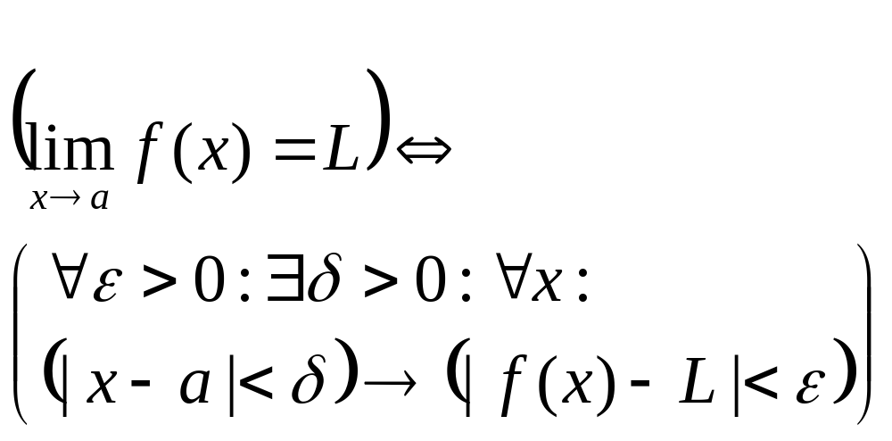
Calculus Example
Precisely defining the concept of a limit using quantifiers:

